Slide 1
Everything from Scratch A journey as Software Engineer in Test to improve "Testing"
Hiroyuki Ito
(@hageyahhoo)

Slide 2
Question
Have you faced with following troubles
for your test-related activities?
Some members/teams opposed your activities
No one used tools/solutions
you invented/introduced
There were few members who have enough skills/knowledge
Notes:
At first, I have a question.
Please raise your hands.

Slide 3
In My Case as SET
No clear goals by senior managers
etc...
Dissension among developers/testers/managers
Negative feedback to
our tools/solutions
Notes:
BTW, who knows the meaning of “SET”?
“SET” stands for “Software Engineer in Test”, who is responsible for improving processes and developments with automation techniques like Test Automation and DevOps.

Slide 4
We can change difficulties into something special with proper approaches!

Slide 5
Our team invented new ideas/tools/solutions from Scratch!

Slide 6
Goal of This Session
Given we have troubles of testing
When we discuss and share troubles
And I share our solutions
Then we get hints to get over them

Slide 7
Agenda
1. Importance of Getting Supports
2. Experience Hardships Together
3. Nurture All for Innovations

Slide 8
1. Importance of Getting Supports
2. Experience Hardships Together
3. Nurture All for Innovations

Slide 9
Let’s Discuss! (5 min)
What blocks/blocked
Test Automation
in your organization?
Notes:
Discussionの内容を2-3共有してもらおう

Slide 10
My Blockers
Hiro’s
Case
By decision-makers/colleagues:
No clear vision/goals
No shared understanding
No supports
Unclear needs/demands

Slide 11
My Blockers
Hiro’s
Case
By decision-makers/colleagues:
No clear vision/goals
No shared understanding
No supports
Unclear needs/demands
They are critical!
Need to solve!

Slide 12
Key Point
How to get support/understanding
from
decision-makers
colleagues

Slide 13
Two Useful Techniques
Product Discovery
Giving Impacts

Slide 14
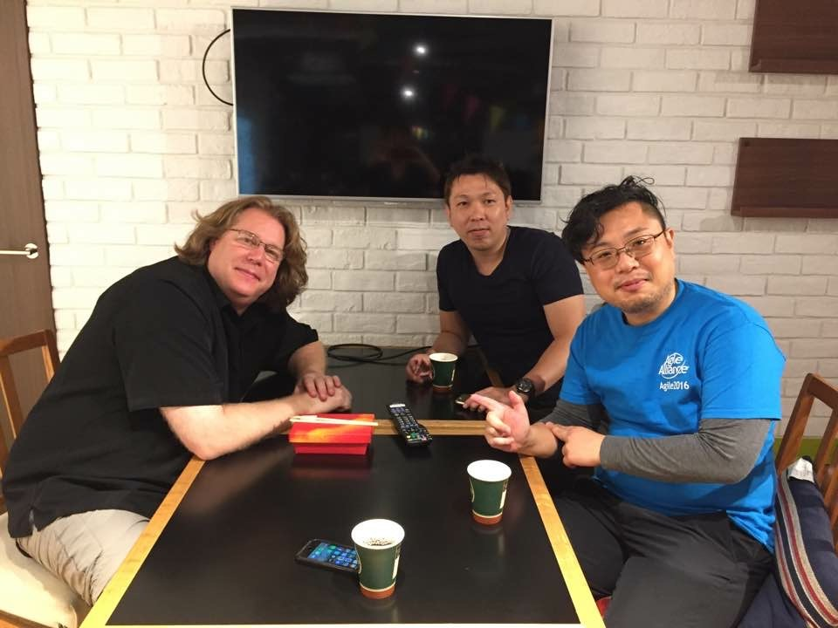
1. Product Discovery
Discovering/refining solutions
by iterative hypothesis and test cycle
By David Hussman
Persona
User Interview
User Story Mapping
MVP
KPI

Slide 15
Discover real concerns of
decision-makers/colleagues
and verbalize them

Slide 16
Verbalized Concerns
Increase of outages in “Channel Gateway” (service) was critical
Need failure detection mechanism for Channel Gateway
Testing APIs was insufficient in each service (Mainly did it manually then)

Slide 17

2. Giving impacts
Making impacts constantly
to attract decision-makers/colleagues

Slide 18



My Example
Hiro’s
Case
Deliver (executable) values weekly

Slide 19
Delivered Values (1)
Week 1 | Started writing test scripts to understand services
Week 2 | Proposed first idea of SET activities to decision-makers
Week 3 | Built mechanism to run and report static code analysis regularly
Week 4 | Shared to developers how to build static code analysis
Week 5 | Proposed milestones of activities to decision-makers

Slide 20
Delivered Values (2)
Week 6 | Agreed with proposals/milestones with decision-makers
Week 7 | Collected information and tools of QA/Tests in one place
Week 8 | Implemented failure detection for Channel Gateway
Week 9 | Guided to start regular meetings with developers and QA persons
Week10 | Started solving problems by developers step by step

Slide 21
Results
Within the first 3 months I joined :D
Many colleagues started talking about SET
Decision-makers started supporting SET activities positively
SET started improvement activities for Channel Gateway service

Slide 22
1. Importance of Getting Supports
2. Experience Hardships Together
3. Nurture All for Innovations

Slide 23
Let’s Discuss! (5 min)
How to persuade
developers
who stopped
writing test scripts?
Notes:
Discussionの内容を2-3共有してもらおう

Slide 24
Key Point
Experiencing hardships with
product development teams together!

Slide 25
One Experience Report
Failure detection system
at Channel Gateway

Slide 26
System Image of CGW
Often caused outages
Tend to delay detecting failures
* This is an image!
Store
User
Channel
Gateway
Game
Others

Slide 27
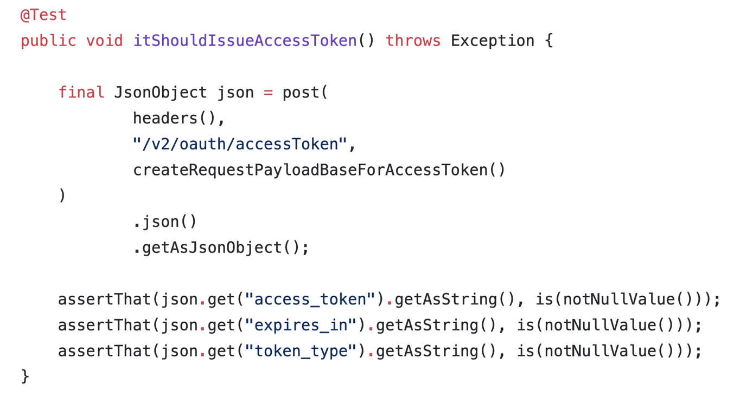
Ver.1 with JUnit and CI

Slide 28
Ver.1 with JUnit and CI
Didn’t become established at this team ☹
Test scripts are hard to read/implement/maintain
for developers/Product Manager

Slide 29
Product Discovery Again!

Slide 30
Karate as a Solution
Open-sourced framework
for testing APIs
Gherkin format
Supports testing RESTful APIs
Easy to expand to test gRPC/Thrift
You can find it on Technology Radar

Slide 31
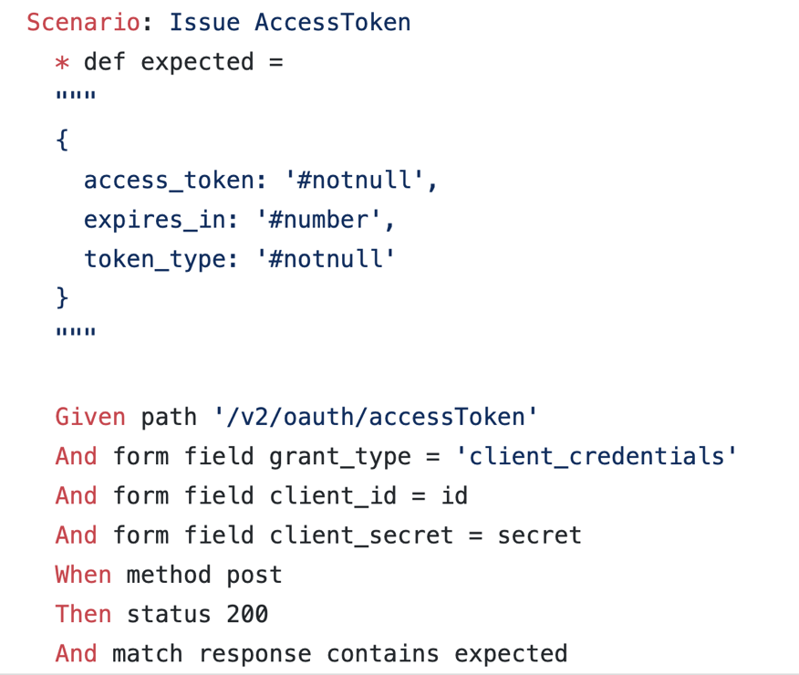
Ver.2 with Karate

Slide 32
Ver.1 with JUnit and CI

Slide 33

Experienced Hardships
With Channel Gateway members together
for 3 months
(CGW)
1) This case is hard to implement.
How to do it?
(SET)
2) OK. How about adding a Plugin like this?
(CGW)
3) Well, how about adding this feature, too?

Slide 34
Result
Became the model case of
improvements in our company!
Outages：- 30%
Failure detection：1 week -> 2 hours
All members have been writing tests (including Product Manager!)

Slide 35
compassion (EN)
compatio (LA)

Slide 36
1. Importance of Getting Supports
2. Experience Hardships Together
3. Nurture All for Innovations

Slide 37
Let’s Discuss! (5 min)
What is
the difficulty of
testing Microservices?
Notes:
Discussionの内容を2-3共有してもらおう

Slide 38
Points
Innovative activities require proper skills, knowledge, persons, and so on.

Slide 39
Learning Session
a way to nurture members, teams, and organizations smoothly and quickly.

Slide 40
Sebas Report
Result of Learning Session
to tame the complexity of Microservices
to reduce their outages

Slide 41
Results
Improved MTTR
Users are increasing

Slide 42
Learning Lesson #とは
業務時間中に実施する
勉強会の手法
Chris Lucianさんから 直接教えていただいた手法
RSGT2019 キーノートスピーカー
モブプログラミングの 創始者

Slide 43
SETチームでのルール
基本毎日、30-60分、業務時間中に実施
業務に役立つトピックであれば何でもOK
基本モブプログラミングで実施
批判はしない
楽しむ！

Slide 44
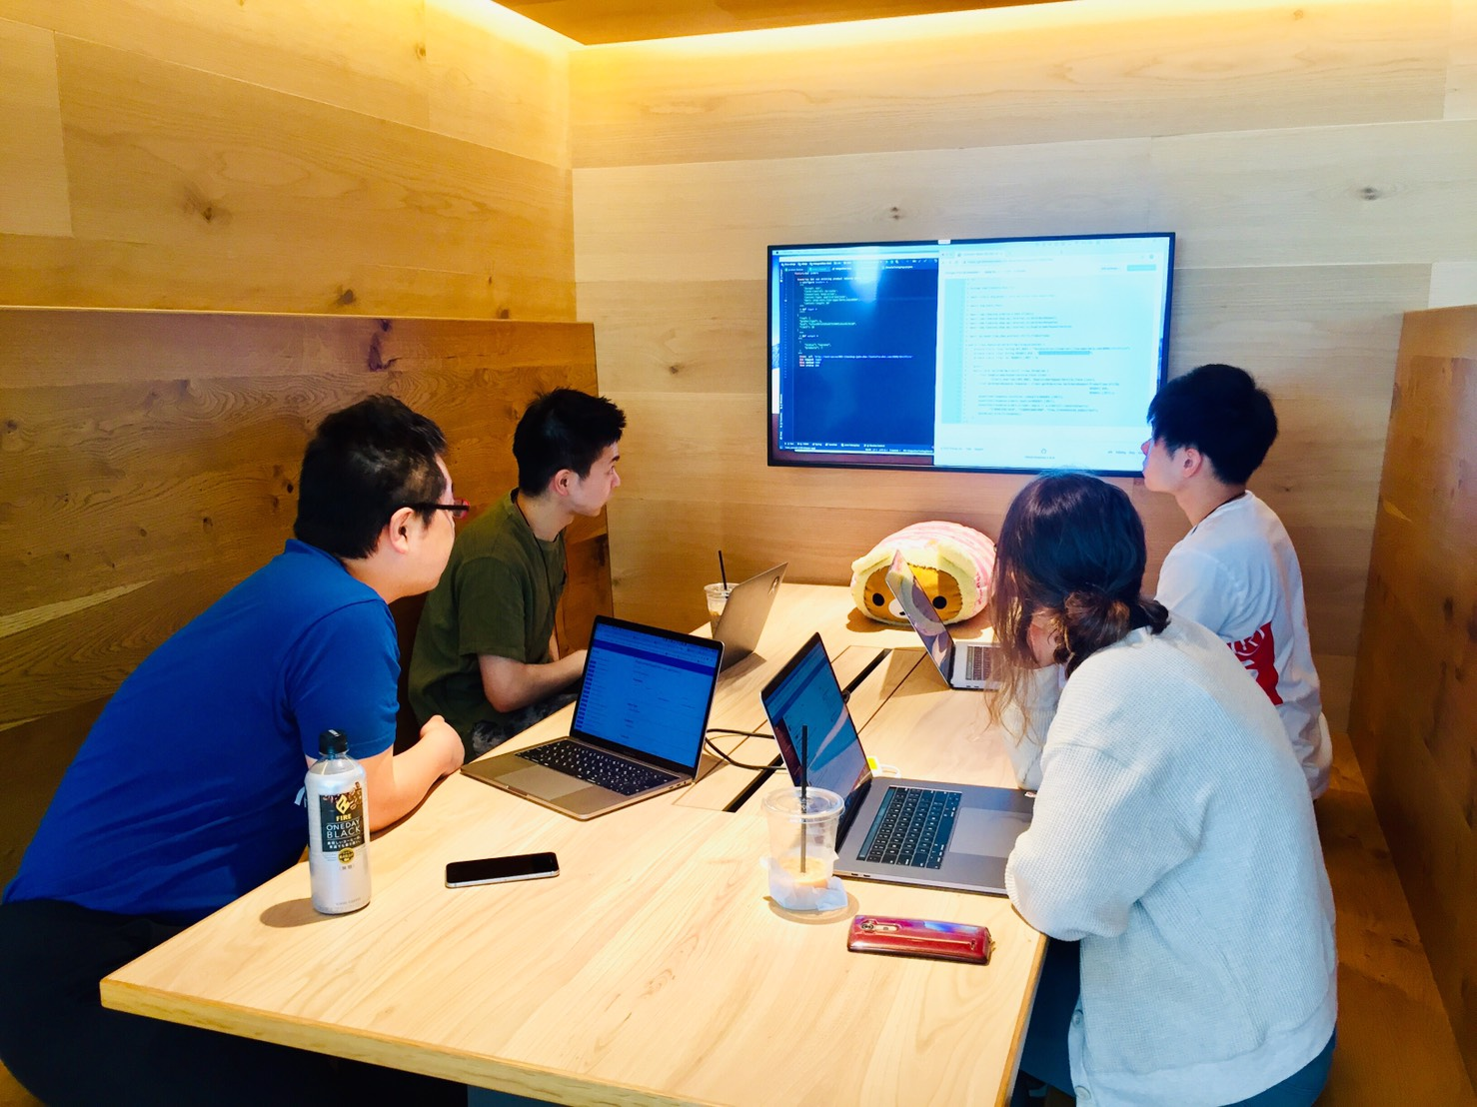
SETチームが学んだこと
Kubernetes
Karate
Vue.js
IntelliJ IDEAの ショートカットキー
ドラッカーエクササイズ
マネージャーをグッと させるレポートの書き方

Slide 45
成果
新メンバーたちが 入社1-2ヶ月で
成果を出せるように
なった！

Slide 46
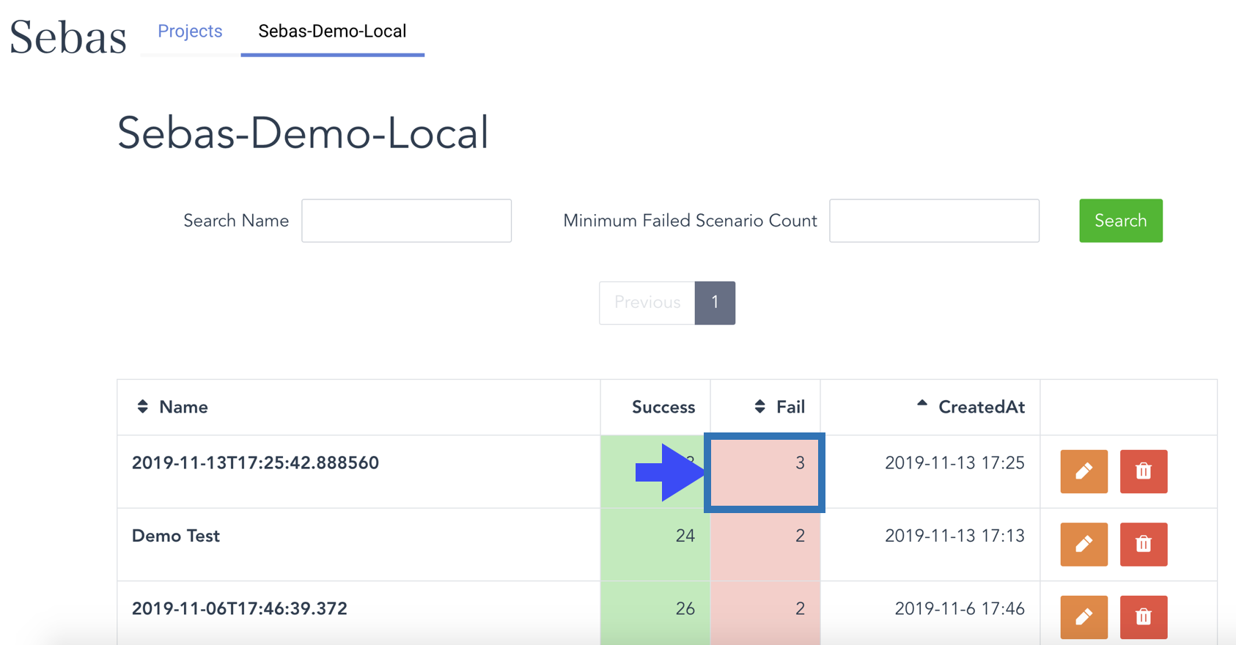
成果例：Sebas Report

Slide 47
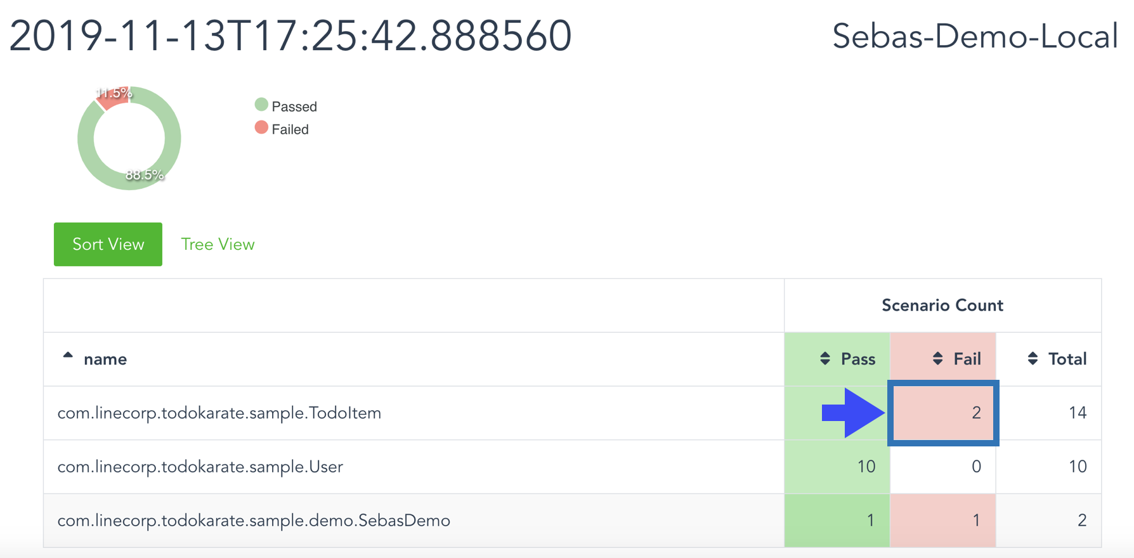
Karateのテストレポートの拡張

Slide 48
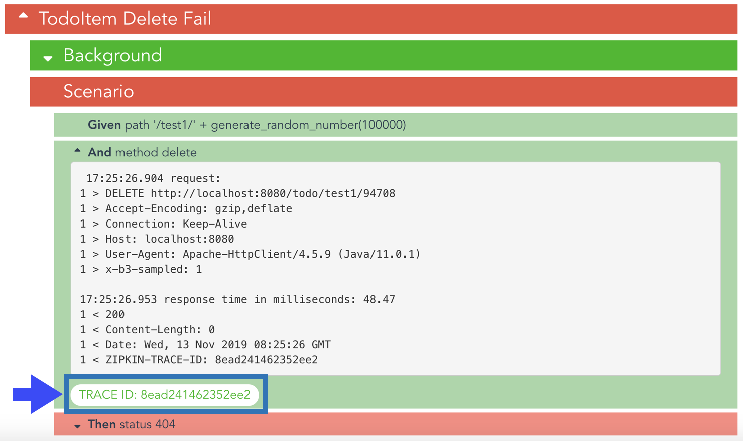
マイクロサービスの障害原因を

Slide 49
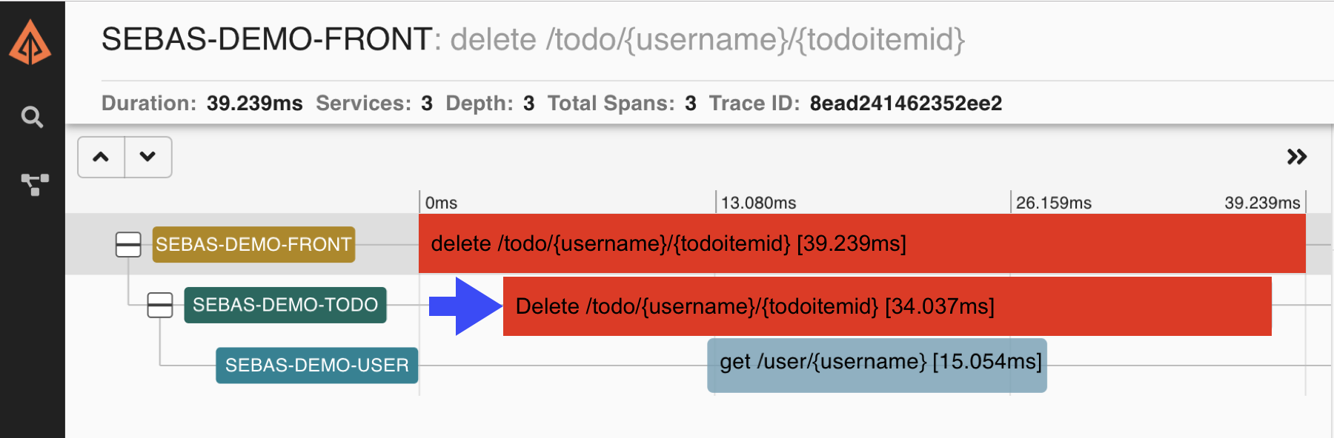
迅速に特定できます

Slide 50

学習したものを活用して…！

Slide 51
Next Actions

Slide 52
Ayaperf
Add later

Slide 53
Design Sprint
Add later

Slide 54
Testable Infrastructure
Add later

Slide 55
Conclusion

Slide 56
Achievements
Some teams convinced themselves with my ideas and started utilizing them.
One team solved its slow test problems on their own.
One team invented a new test infrastructure which made testing easier.

Slide 57
Conclusion
We can change difficulties into something special with proper approaches!

Slide 58
皆さんに 適した 解決策を 皆さんの 手で！

